Slide 1

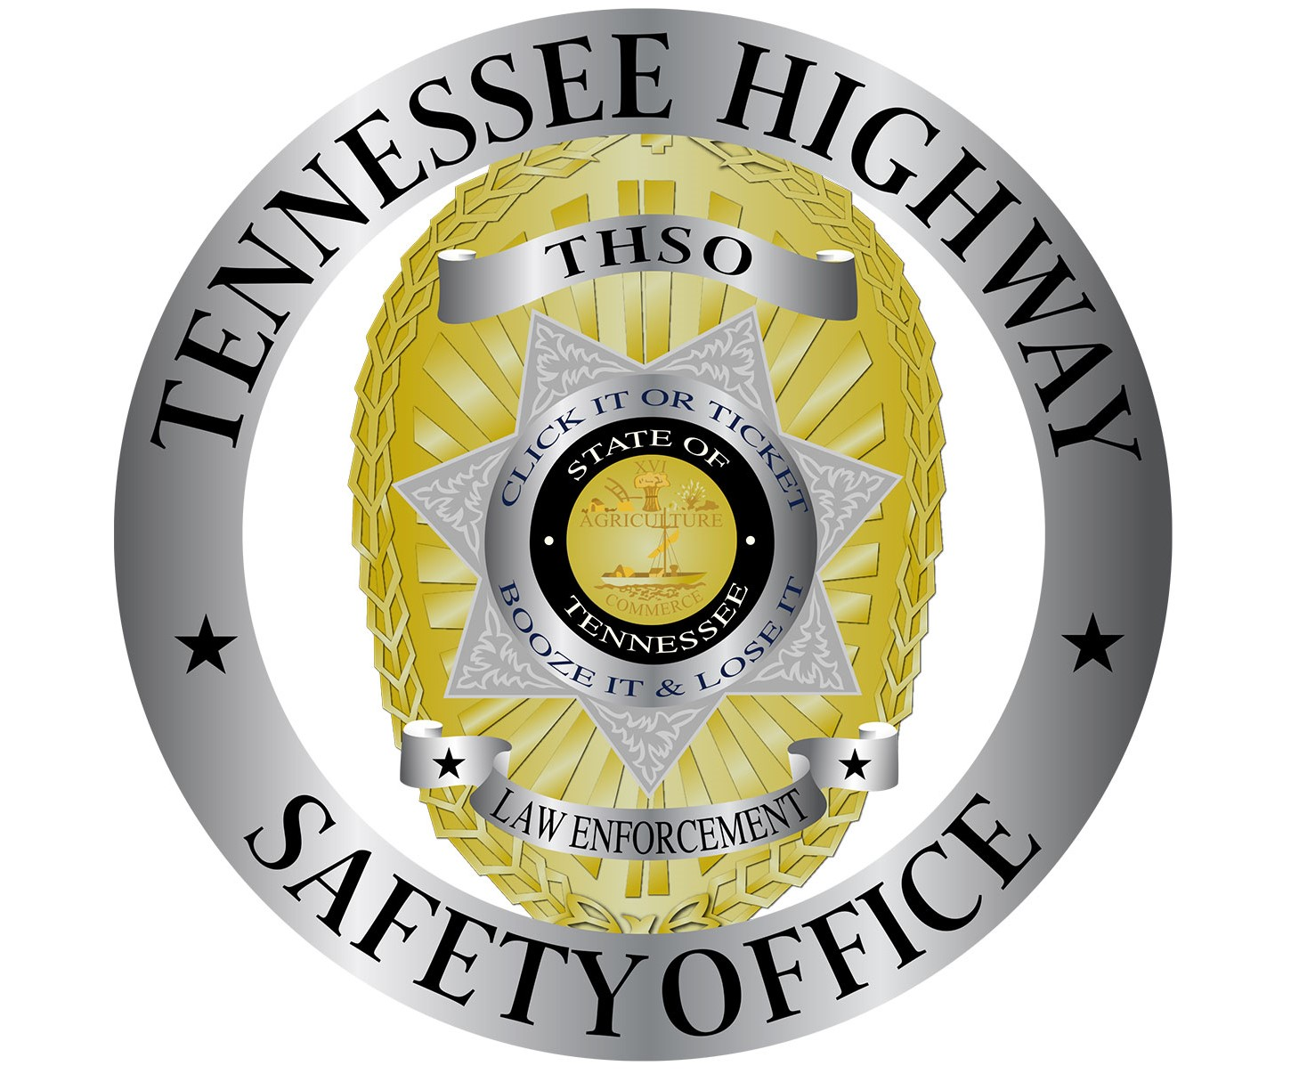
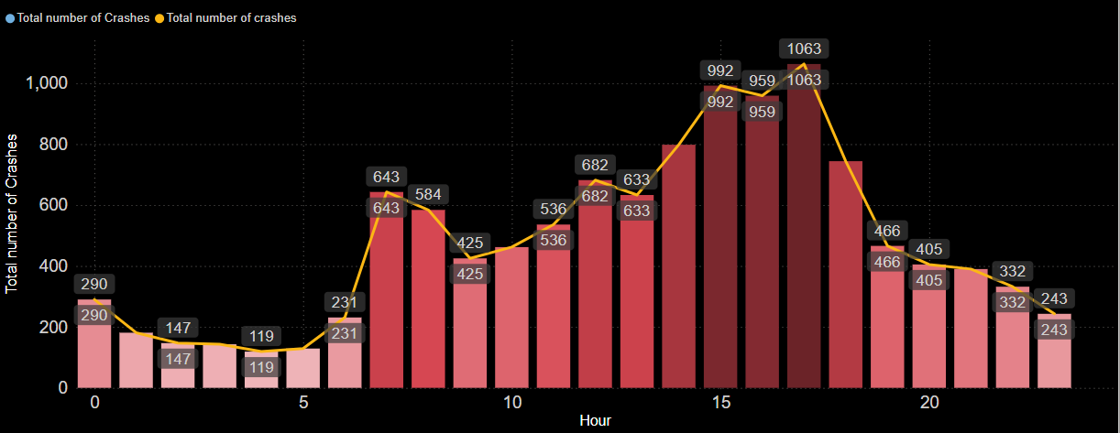
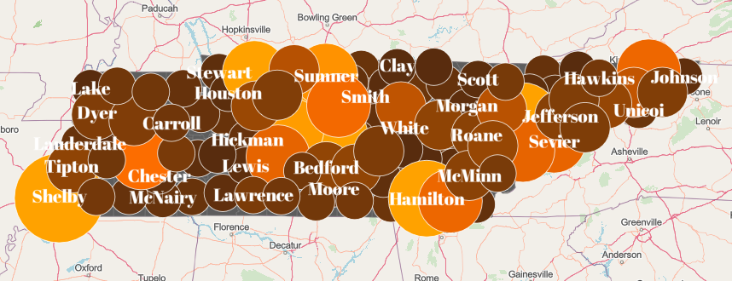
Comparative Analysis of Reduced Distracted Driving Among Shelby County Adolescents from 2023 to 2025
Dr. Sabyasachee Mishra, Dr. Subhash Jha, Veera Manikanda Prabhu, Louis Asare Gyasi
INTRODUCTION
FINDINGS
According to the National Highway Traffic Safety Administration (NHTSA, 2023), fatal crashes involving distracted driving have shown an increasing trend in recent years, with adolescents representing the age group with the highest proportion of such crashes.
OBJECTIVES
Compare awareness and knowledge among University of Memphis students between 2023 and 2025.
Identify effective mediums for reducing distracted driving among adolescents.
Utilize a driving simulator to analyze perceptions of distractions in and around the vehicle.
Assess participants’ reactions to roadway advertisements to determine effectiveness
Hourly variation of crash incidents within Shelby County
STUDY AREA
State of Tennessee with a focus on Shelby County
Statewise spatial variation of crash incidents

